Slide 1
SYSTEMS
ANALYSIS AND DESIGN
Nguyen Thanh Binh, Nguyen Quang Vu, Le Viet Truong, Nguyen Thi Hanh, Vo Van Luong, Le Thi Bich Tra
Faculty of Computer Science

Slide 2
Design principles
General Responsibility Assignment Software Principles/Patterns - GRASP

Slide 3
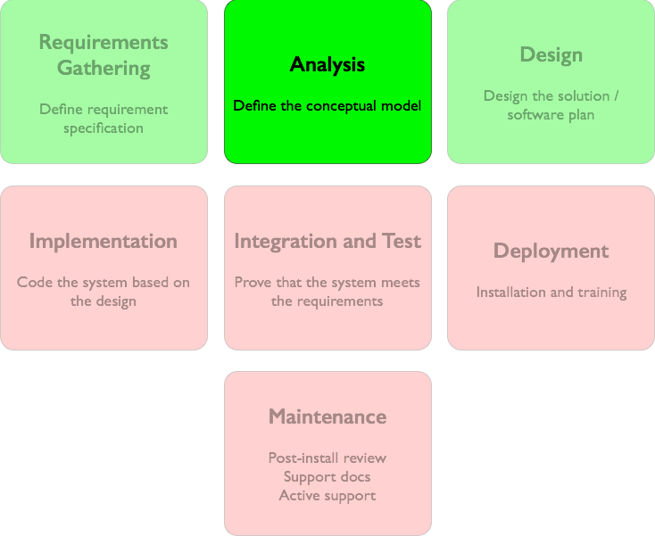
Analysis phase
The analysis phase provides an understanding of the requirements, concepts and the behaviour of the system.
Some documents may be obtained at the end of the analysis phase
  A description of the functionalities
  A description of the use-cases
  A description of the conceptual models
  The system sequence diagrams
  Activity diagrams

Slide 4
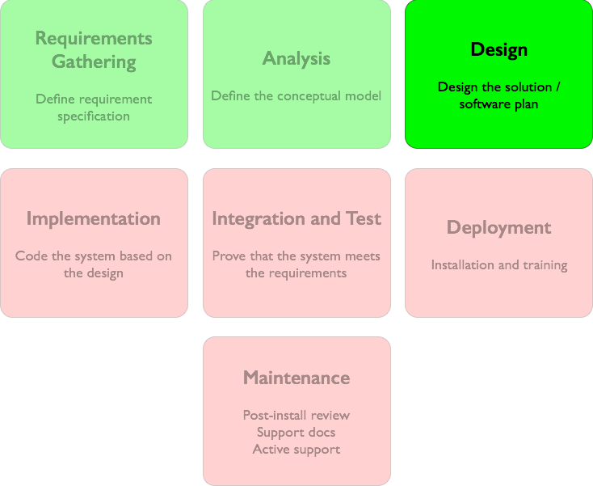
Design phase
The design phase is to construct diagrams to describe communications between objects and their responsibilities to meet the requirements
The resulting main diagrams in the design phase are
  Class diagrams
  Interaction diagrams
This phase requires some design principles
  GRASP design principles
  GoF Design patterns

Slide 5
Understanding responsibilities is key to object-oriented design.
Martin Fowler

Slide 6
Responsibilities-Driven Design
RDD is a metaphor for thinking about object-oriented design.
Think of software objects similar to people with responsibilities who collaborate with other people to get work done.
RDD leads to viewing an OO design as a community of collaborating responsible objects.

Slide 7
GRASP
General Responsibility Assignment Software Patterns or Principles (GRASP)
  Pattern is a solution which can be applied to a problem in a new context
A learning aid for OO Design with responsibilities.
A collection of patterns/principles for achieving good design - patterns of assigning responsibility.

Slide 8
Responsibility
A responsibility is an duty or a contract of a class
The determination of the attributes and operations of a class is essentially based on its responsibilities
The responsibilities of an object relate to the behavior of an object
Two main types of responsibility
  Do
    The object accomplishes something itself
    The object initiates an action of another object
    The object controls or coordinates activities of other objects
  Know
    The object knows private encapsulated data
    The object knows the objects to which it is linked
    The object has data that it can calculate or derive

Slide 9
Responsibility
The responsibilities are assigned to classes during the design phase
  Example
    An object of Sale class is responsible for creating an object of Payment class (do)
    An object of Sale class is responsible for knowing its total (know).
The translation of responsibilities into methods of classes depends on the granularity of the responsibilities
  A responsibility can be translated by several methods of several classes
    Responsibility “offer access to the database” can be translated to several methods of several classes
  A responsibility can be translated by one method
    Responsibility “create a Sale” can be translated by only one method.

Slide 10
Assignment and discovery of responsibilities
The assignment of responsibilities to objects is very important in object-oriented design.
The discovery of responsibilities is achieved when building interaction diagrams
:Sale
pay(amount)
<<create>>
:Payment

Slide 11
GRASP patterns
We consider 5 among 9 GRASP patterns/principles
  Low Coupling: assigning responsibilities in a low coupling way
  High Cohesion: assigning the responsibilities to ensure that cohesion remains high
  Creator: assigning the creation responsibility of an object to another object
  Information Expert: the common principle when assigning responsibilities to classes
  Controller: assigning the responsibility for management of the system event messages
  Polymorphism
  Indirection
  Pure fabrication
  Protected variations

Slide 12
Coupling and Cohesion
Coupling: Amount of relations between objects/sub-systems
Cohesion: Amount of relations within sub-system
Coupling
Cohesion
Sub-system 1
Sub-system 2

Slide 13
Properties of a good architecture
Minimises coupling between modules
  Goal: modules don’t need to know much about one another to interact
  Low coupling makes future change easier
Maximises cohesion within modules
  Goal: the content of each module are strongly inter-related
  High cohesion makes a module easier to understand

Slide 14
Low coupling
Problem: How to support low dependency, low change impact, and increase reuse?
Coupling:
  Measure how strongly one element is connected to, has knowledge of or relies on other elements
  An element with low (or weak) coupling is not dependent on two many other elements

Slide 15
When are two classes coupled?
Common forms of coupling from TypeX to TypeY
  TypeX has an attribute that refers to a TypeY instance
  A TypeX object calls on services of TypeY object
  TypeX has a method that references an instance of TypeY (parameter, local variable, return type)
  TypeX is a direct or indirect subclass of TypeY
  TypeX is an interface and TypeY implements that interface

Slide 16
High coupling (Bad)
A class with high (or strong) coupling relies on many other classes. Such classes may be undesirable and suffer from the following problems:
  Force local changes because of changes in related classes
  Harder to understand in isolation
  Harder to reuse because its use requires the additional presence of the classes on which it is dependent

Slide 17
Solution
Assign responsibility so that coupling remain low
Use this principle to evaluate alternatives

Slide 18
Low Coupling pattern
Coupling
  the dependency between objects
When depended upon element changes, it affects the dependant also
  Two elements are coupled, if
    One element has aggregation/composition association with another element
    One element implements/extends other element
  A class has a low coupling if it is not dependent on too many other classes
:A
:B
:C

Slide 19
Low Coupling pattern
Problem
  How can we reduce the impact of change in depended upon elements on dependant elements?
Solution
  Assign responsibilities so that coupling remain low
  Minimise the dependency hence making system maintainable, efficient and code reusable
:A
:B
:C
:A
:B
:C

Slide 20
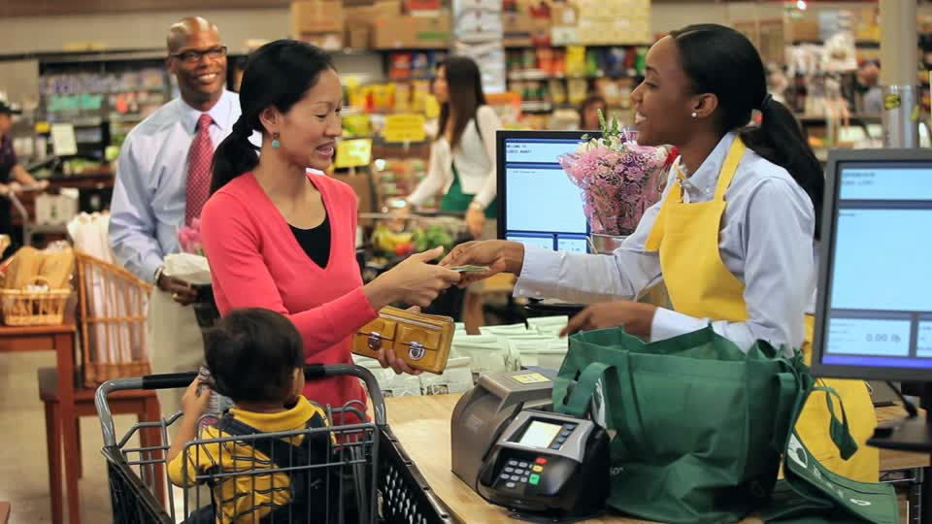
Example
We have three following classes in the Cash Register system
Supposing that we would like to create an instance of Payment and associate it with Sale.
How can we assign responsibilities to adhere to Low Coupling pattern?
Register
Payment
Sale

Slide 21
Solutions
1: create()
Solution 1
Solution 2
:Register
p:Payment
2: addPayment(p)
:Sale
1: createPayment()
:Register
:Sale
1: create()
:Payment

Slide 22
Solutions
Solution 1: Register knows both Payment and Sale. Register depends on both Payment and Sale.
Solution 2: Register and Sale are coupled, Sale and Payment are coupled.
1: create()
:Register
p:Payment
2: addPayment(p)
:Sale
1: createPayment()
Lower coupling
:Register
:Sale
1: create()
:Payment

Slide 23
High Cohesion pattern
Problem
  How to ensure that the operations of any element are functionally related?
Solution
  Clearly define the purpose of the element
  Gather related responsibilities into an element
Benefit
  Easily to understand and maintain

Slide 24
Low cohesion
A class with low cohesion does many unrelated things or does too much work. Such classes are undesirable; they suffer from the following problems:
  hard to comprehend
  hard to reuse
  hard to maintain
  constantly affected by change

Slide 25
High Cohesion pattern
Student
Example for Low Cohesion
:Student
getStudentDetails()
accessDB()
dbCalls()
insertDB()
getStudentDetails()
accessDB(), dbCalls()
insertDB()

Slide 26
High Cohesion pattern
Student
Example for High Cohesion
:Student
:DB
getStudentDetails()
getStudentDetails()
DB
accessDB()
dbCalls()
insertDB()
insertStudent(data)
accessDB(), dbCalls()
insertDB(data)

Slide 27
Rules of thumb
For high cohesion, a class must
  have few methods
  have a small number of lines of code
  not do too much work
  have high relatedness of code

Slide 28
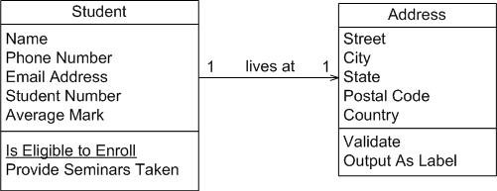
TODO http://www.agilemodeling.com/artifacts/classDiagram.htm example if low and high cohesion

Slide 29
“creator” pattern
Problem
  Who is responsible for creating objects/instances of a class?
Example
  Who should be responsible for creating a SalesLineItem instance?
Sale
time
1
contains
1..*
1
*
described-by
ProductDescription
SalesLineItem
description
price
itemID
quantity

Slide 30
“creator” pattern
Example (continue)
  Sale contains SalesLineItem, so Sale should be responsible for creating objects of SalesLineItem
    “makeLineItem(quantity)” method will be introduced to Sale class
:Register
:Sale
makeLineItem(quantity)
create(quantity)
:SalesLineItem

Slide 31
“creator” pattern
Discussion
  Basic idea is to find a creator that needs to be connected to the created object in any event
  Also need initialisation data to be nearby - sometimes requires that it is passed into client. e.g., ProductionDescription needs to be passed in.
  Assign class B the responsibility to create an instance of class A if one of these is true
    B contains A
    B aggregates A
    B has data for initialising A
    B closely uses A

Slide 32
“creator” pattern
Application
  Guide in the assigning responsibility for creating objects
  Help to find the class who is responsible for creating objects
Advantages
  The “creator” pattern supports the low coupling between classes
    Fewer dependencies and more reusability
    The coupling is not increased because the created class is visible to the “creator” class

Slide 33
Information Expert pattern
Problem
  What is the general principle of assigning responsibilities to objects?
    Consider that there may be 100s or 1000s of classes
    To which ones do we assign a particular functionality?
    Assigning well makes our design easier to understand, maintain, extend and reuse.
Solution
  Assign responsibility to the information expert - the class that has the information to fulfil the responsibility
Application
  One of the most used patterns in object-oriented design
  Accomplishing of a responsibility can request information distributed among several objects or classes, this implies several “partial experts” working together to fulfil the responsibility

Slide 34
Information Expert pattern
Example
  In the CashRegister system, who is responsible for knowing the grand total of a Sale?
Sale
time
1
contains
1..*
1
*
described-by
ProductDescription
SalesLineItem
quantity
description
price
itemID

Slide 35
Information Expert pattern
Example: Responsibilities
Sale
time
1
contains
1..*
1
*
described-by
ProductDescription
SalesLineItem
description
price
itemID
quantity
Class | Responsibility
Sale | knows sale total
SaleLineItem | knows line items subtotal
ProductDescription | knows product price

Slide 36
Information Expert pattern
Example (continue)
  To calculate grand total of a Sale, it is necessary to know the instances of SalesLineItem and the sub-total of each instance.
  According to the pattern, Sale knows the information
Sale
time
1
contains
1..*
1
*
described-by
ProductDescription
SalesLineItem
quantity
description
price
itemID

Slide 37
Information Expert pattern
Example (continue)
  Introduce “getTotal()” method to Sale class
t = getTotal()
Sale
:Sale
time
getTotal()

Slide 38
Information Expert pattern
Example
  Then, we need to determine the sub-total of each SalesLineItems. To do so, we need to know the number of ProductDescription
  According to the pattern, SalesLineItem is the expert.
Sale
time
1
contains
1..*
SalesLineItem
*
described-by
1
ProductDescription
quantity
description
price
itemID

Slide 39
Information Expert pattern
Example
  Introduce the “getSubTotal()” method to SalesLineItem class
Sale
time
t = getTotal()
1: *: st = getSubTotal()
getTotal()
:Sale
lineItems[i] :
SalesLineItem
SalesLineItem
quantity
getSubTotal()

Slide 40
Information Expert pattern
Example
  To calculate the sub-total, SalesLineItem needs to know the price of each product.
  ProductionDescription est expert.
Sale
time
1
contains
1..*
SalesLineItem
*
described-by
1
ProductDescription
quantity
description
price
itemID

Slide 41
Information Expert pattern
Example
  Introduce the “getPrice()” method to ProductDescription class
t = getTotal()
1: *: st = getSubTotal()
Sale
:Sale
lineItems[i] :
SalesLineItem
time
getTotal()
1.1: getPrice()
SalesLineItem
quantity
getSubTotal()
:ProductDescription
ProductDescription
description
price
itemID
getPrice()

Slide 42
Information Expert pattern
Advantages
  The encapsulation is maintained since objects use their own information to satisfy responsibility
  This pattern supports loose coupling, this allows the system to be more robust and easier to maintain
  The behaviour is distributed among the classes that possess the necessary information, it encourages more coherent and smaller definitions are easier to understand and maintain

Slide 43


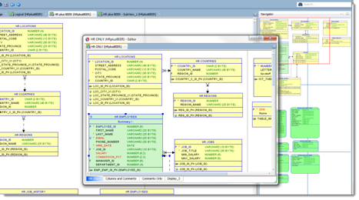
Controller pattern
Problem
  Which first object beyond the User Interface (UI) layer receives and coordinates (“controls”) a system operation?
Presentation Layer
Web UI
Desktop UI
Mobile UI
events / requests
Business Logic Layer
:Class ???

Slide 44
Controller pattern
Solution
  A Controller is the first object beyond the UI layer that is responsible for receiving and handling a system operation.
  A controller should delegate the work to other objects. The controller only receives the requests but doesn’t not actually solve them.
Presentation Layer
Web UI
Desktop UI
Mobile UI
events / requests
Business Logic Layer
:Controller

Slide 45
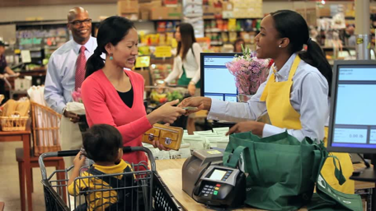
Controller pattern
Application
  The Controller pattern can be applied to all the systems that need to process external events
  A controller class is selected to process the events
Example
  The Cash Register system has several events
  What class can be the controller (i.e., what class processes the events)?
System
endSale()
enterItem()
makeNewSale()
makePayment()
makeReturnItem()
enterReturnItem()
….
Web UI
Presentation Layer
Desktop UI

Slide 46
Controller pattern
Example: Cash Register system
  Solution 1: use one controller
System
Web UI
endSale()
enterItem()
makeNewSale()
makePayment()
makeReturnItem()
nterReturnItem()
….
Presentation Layer
Desktop UI
events / requests
Register
endSale()
enterItem()
makeNewSale()
makePayment()
makeReturnItem()
enterReturnItem()
….
Business Logic Layer

Slide 47
Controller pattern
Example: Cash Register system
  Solution 2: use several controllers
System
Presentation Layer
endSale()
enterItem()
makeNewSale()
makePayment()
makeReturnItem()
enterReturnItem()
….
Web UI
Desktop UI
events / requests
Business Logic Layer
ProcessSaleHandler
HandleReturnsHandler
endSale()
enterItem()
makeNewSale()
makePayment()
makeReturnItem()
enterReturnItem()
….

Slide 48
Controller pattern
Discussion
  Advantages
    This is simply a delegation pattern - the UI should not contain application logic
    Increase potential for reuse and pluggable interfaces
    Creates opportunity to reason about state of a use-case, for example, to ensure that operations occur in a legal sequence.
Presentation Layer
Web UI
Desktop UI
Mobile UI
events / requests
Business Logic Layer
:Controller

Slide 49
Controller pattern
Discussion
  Difficulty: Bloated controllers
    a single controller that receives all system events, does too much of the work handling events, has to many attributes (duplicating information found elsewhere), etc.
    Remedies
      Add more controllers
      Design controller so that it primarily delegates the fulfilment of each system operation to other objects.
System
Presentation Layer
…
events / requests
ProcessSaleHandler
HandleReturnsHandler
endSale()
enterItem()
makeNewSale()
makePayment()
makeReturnItem()
enterReturnItem()
….
Business Logic Layer

Slide 50
Conclusions

Slide 51
Conclusions
Distinction between functional approach and object-oriented approach
Master the basic object-oriented concepts
UML: a modelling language
  Need a development process
  Different views
  Different models
  Use of the models in different development activities
Master the main diagrams
  Use-case diagram
  Class diagram
  Interaction diagram

Slide 52
Conclusions
The UML concepts can be extended
  The extensions
Transformation of models to code
  Models independent of programming language
The automatic code generation is only a supplement
  The models guide the coding process
Master design principles
  GRAPS principles/patterns
  Some design patterns

